Slide 1
Executive Summary
Bond Particulars
Yield Chart
Bond Name | CBB INTL SUKUK SIX
Country | Bahrain
Term (Years) | 7.5 Years
Maturity date | 03/20/2025
Last Price (USD) | 99.6 USD
Coupon Rate | 5.25%
Yield to Maturity (YTM) | 6.70%
Credit Ratings (S&P/Fitch/ Moody’s) | B+/B+/ NA
Currency | USD
Rank | Sr. Unsecured
6.77%
6.71%
Actual and Theoretical Yields: The bond’s actual yield stands at 6.70%, with a theoretical yield of 6.77%, based on the US 10-Year Treasury yield (4.61%) and the current CDS spread (2.16%). The slight discount of 0.07% highlights its risk-adjusted value proposition.
Additionally, the CDS spread over the past 5 years suggests improving risk perceptions for Bahrain’s credit profile.
Macroeconomic highlights:
Bahrain’s fiscal stability is challenged by high debt (~120 -130% of GDP) and reliance on oil revenues.
Monetary policy is limited, with Bahrain following U.S. monetary policy due to the dollar peg.
External risks are elevated, with high exposure to oil price volatility and geopolitical tensions.
Bahrain benefits from implicit support from GCC entities such as Saudi Arabia and UAE.
The current account remains in surplus, driven by oil revenues, unlike many global peers.
Source: Bloomberg data, Damodaran online, Central bank of Bahrain, Torch estimates

Slide 2
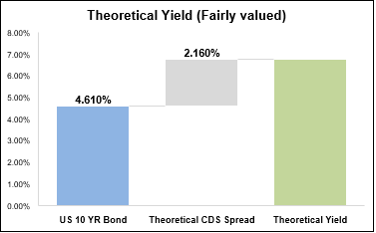
**Bahrain's Economy Overview**
Bahrain's economy has demonstrated resilience and adaptability in recent years. Key highlights include:
* The Bahrain All Share Index has shown an increase, with the Materials, Industrials, and Consumer Discretionary sectors experiencing growth in 2023.
* The Bahrain Islamic Index has also seen a significant increase of 9.9% in 2023, reaching 728.91 points, with 14 Shariah-compliant companies listed.
* The Bahrain Bourse's market capitalization stood at BHD 7.8 billion in 2023, although this represents a 31.9% decrease from 2022.
* The Financials sector remains the dominant sector in terms of market capitalization, accounting for 60% of the total market capitalization.
* Trading activity has been robust, with the total number of transactions increasing by 13.9% in H1 2023 compared to H1 2022.
* The volume and value of card transactions in Bahrain have also increased, with significant growth in transactions by cards issued outside Bahrain.
Overall, Bahrain's economy has shown signs of growth and diversification, with a strong focus on Islamic finance and a resilient financial sector. However, the decline in market capitalization suggests that the economy is not immune to external challenges. As the country continues to develop its economic framework, it is essential to monitor these trends and adapt to changing market conditions to ensure sustainable growth and stability. Key areas of focus include:
* Diversifying the economy to reduce dependence on a single sector
* Encouraging foreign investment and trade
* Developing the Islamic finance sector further
* Supporting small and medium-sized enterprises (SMEs) to promote entrepreneurship and job creation.
Yield Analysis
Actual yield | 6.70%
US 10 Yr Bond yield – (1) | 4.61%
Theoretical CDS Spread – (2) | 2.16%
Theoretical Yield (1+2) | 6.77%
Premium/ (Discount) | (0.07%)
Macroeconomic Analysis
Factor | Bahrain | United States
GDP Growth | 3.0% year-on-year growth in 2023, stable | Stable, diverse economy, moderate growth (~2-3%)
Fiscal Stability | High debt, vulnerable fiscal position, oil-reliant | High fiscal stability, large and flexible economy
Inflation | similar inflation, dollar-pegged currency | FED targeting ~2%
Monetary Policy | Limited control, follows U.S. monetary policy | Flexible, controlled by the Federal Reserve
External Risks | High (oil price volatility, regional tensions) | Moderate (geopolitical, global downturns)
Investment Sentiment | Smaller economy and oil-dependent | Highly attractive, large financial market
Degree of Indebtedness | Debt as % GDP (~120-130%, with high reliance on external borrowing) | Debt as % GDP (~125-130%)
Revenues/Inflows to Government | Volatile, heavily reliant on oil revenues, not stable | High stability due to economic diversification
Political Risk | Politically stable outlook, implicit backing from Saudi Arabia | Politically stable, global influence
Current Account | Surplus, no major issues (surplus due to oil revenues) | Deficit in recent years (~2-3% of GDP)
Torch View: To be revised (if required)
Strengths:
Steady GDP growth supported by non-oil sector diversification.
Controlled inflation stabilized around ~2%
Implicit backing from the GCC Region, not much political risk as well
Weaknesses:
High and rising public debt levels
Limited monetary policy flexibility due to the dollar peg
Government revenues are not growing, heavy reliance on oil revenues and exposure to oil price volatility
Investment Outlook:
Fairly valued yield and strong risk-adjusted return make the bond attractive for income-focused investors
Cautious macroeconomic outlook, small and oil-dependent economy
XXXX
Source: Bloomberg data, Damodaran online, Torch estimates

Slide 3
Fiscal Balance:
The fiscal balance as a percentage of GDP for Bahrain is not explicitly stated in the provided context. However, the financial sector's contribution to GDP is mentioned, representing 17.3% of real GDP in Q2 2023, with a slight decline from previous years.
Debt to GDP Ratio:
The debt to GDP ratio for Bahrain is not explicitly stated, but personal loans as a percentage of GDP decreased to 35.0% by December 2023. Total banking sector assets reached USD 238.5 billion, with retail banking assets at USD 107.1 billion, representing 44.9% of the total.
Net Issuance vs Fiscal Deficit:
Bahrain's net issuance and fiscal deficit show a positive correlation, with a 13.9% increase in transactions in H1 2023, indicating economic growth, while the fiscal deficit is managed through monetary policy, maintaining financial stability. Key highlights:
* Increased transactions: 88.7 million (H1 2023)
* Fiscal deficit management: through monetary policy.
GDP Growth: Bahrain's GDP growth: 3.5% in 2022, expected 3.0% in 2023, with 2.1% in the US, 5.0% in China, and 0.7% in the Euro Area.
Inflation Rate: Bahrain's inflation rate has remained relatively stable due to the Bahraini Dinar's peg against the U.S. Dollar, maintaining price stability over the years.
Unemployment Rate: Bahrain's unemployment rate is not mentioned in the provided context, only financial stability and market data are discussed.
Fiscal Balance: Bahrain's fiscal balance is not explicitly stated, however, the financial sector contributes 17.3% to GDP, with a stable banking sector assets growth of USD 238.5 billion.
Debt to GDP Ratio: Bahrain's debt to GDP ratio has fluctuated, with personal loans as a percentage of GDP decreasing to 35.0% by December 2023.
Net Issuance: Bahrain's net issuance reached USD 14.1 billion in 2023, with 61 offering documents approved by the CBB, indicating a notable increase in capital market activities.
Figure 1
Figure 2
Figure 3
Source: Bloomberg data, IMF, MOFNE, Central bank of Bahrain, Torch estimates

Slide 4
Financial Stability Analysis
Fiscal Balance as % of GDP: Bahrain’s fiscal balance has improved significantly in recent years, supported by higher oil revenues and enhanced fiscal discipline (Figure 4). The Economic Recovery Plan, launched in response to the pandemic, has accelerated reforms aimed at expenditure rationalization and non-oil revenue generation. While the fiscal deficit remains a concern, projections indicate a gradual return to surplus by 2030, contingent on sustained policy implementation and stable oil market conditions.
Debt to GDP Ratio: Bahrain’s gross debt-to-GDP ratio has shown a consistent upward trend, reflecting challenges in managing public debt levels amidst fiscal deficits (Figure 5). The ratio rose sharply in 2020 due to pandemic-related spending but has since stabilized, supported by fiscal reforms and higher oil revenues. Projections suggest a continued increase, albeit at a slower pace, underscoring the need for sustained efforts in debt management and economic diversification to mitigate long-term fiscal risks
Net Issuance vs Fiscal Deficit: Net issuance in Bahrain closely mirrors fiscal deficit trends, underscoring the reliance on debt markets to bridge fiscal gaps (Figure 6). A sharp rise in issuance during the pandemic years reflects increased government borrowing to sustain expenditures amidst revenue shortfalls. The alignment of issuance strategy with fiscal policies will remain crucial to maintaining investor confidence and ensuring sustainable debt levels.
Figure 4
Figure 5
Figure 6
Key Observations:
Bahrain’s GDP growth rebound post-pandemic highlights its reliance on non-oil sector resilience and the recovery in oil prices, with growth projected to stabilize at 2-3%.
Inflation stabilization at 2% demonstrates effective fiscal measures, but global supply chain and commodity price risks persist.
Stable unemployment rates at 6-7% reflect the success of Bahrainization policies, but high-value job creation remains a pressing need for the youth workforce.
The narrowing fiscal deficit, supported by higher oil revenues and VAT introduction, shows progress in fiscal consolidation, with a potential surplus projected by 2030.
Rising debt-to-GDP levels, while stabilizing, emphasize the urgency for continued fiscal discipline and effective public debt management strategies to ensure long-term sustainability.
The net issuance remains closely tied to fiscal deficit management (Figure 6), reflecting Bahrain’s reliance on debt markets to fund fiscal gaps. Effective synchronization between fiscal policy and issuance strategy is critical to maintain market confidence and avoid crowding-out effects on private sector borrowing.
Source: Bloomberg data, IMF, MOFNE, Central bank of Bahrain, Torch estimates

Slide 5
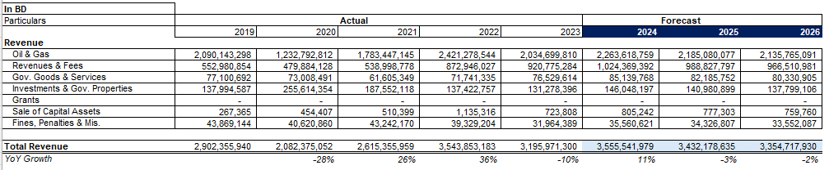
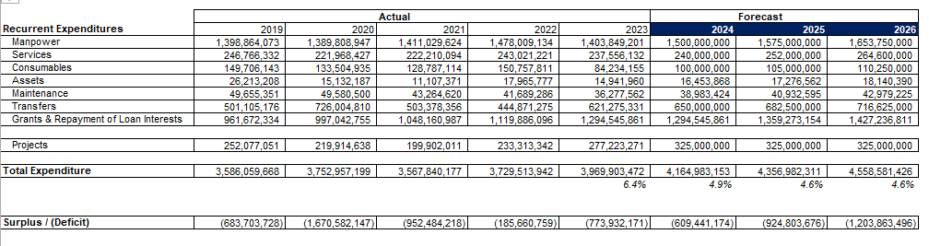
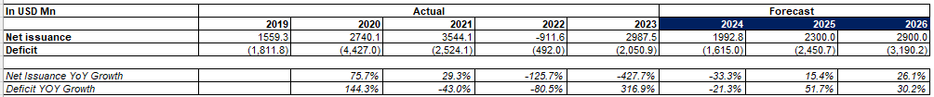
Appendix
Financial Projections

Slide 6
Disclaimer
This Information Presentation is provided solely for the information and exclusive use of the Recipient, and may not be communicated, photocopied, reproduced, disclosed, or distributed to any other person at any time except as agreed in writing by the Company.
This Information Presentation is not an offer or invitation to sell or acquire any shares, securities or any assets or other interests of whatever nature and shall not be taken as any form of commitment or recommendation on the part of the Company to proceed with any transaction. A proposal regarding the Transaction will only give rise to any contractual obligations, express or implied on the part of the Company when a definitive agreement has been executed. Nothing contained herein shall be deemed to constitute an agreement by the Company to permit the Recipient to have unrestricted or any other type of access to the Company’s information, books, records, employees or otherwise.
This Information Presentation includes forward-looking statements. The Company has based these forward-looking statements on its current expectations and projections about future events. These forward-looking statements are subject to risks, uncertainties, and assumptions about the Company and the business environment. The Company’s actual results of operations may differ materially from the forward-looking statements. The Company undertakes no obligation to update or revise this Information Presentation, whether as a result of new information, future events, or otherwise. In considering any prior performance information contained herein, the Recipient should note that past performance is not necessarily indicative of future results, and there can be no assurance that any transaction will achieve comparable results or that targeted returns will be met.
In accepting delivery of this Information Presentation, the Recipient agrees that no information contained in this Information Presentation or any other written or oral communication transmitted or made available to the Recipient pursuant to or in connection with this Information Presentation (collectively, “Information and Communication”) is, or shall be relied upon as a promise or representation, whether as to the past or the future, and no liability will attach, except as provided in a definitive agreement between the recipient and the Company, when, and if it is executed, and subject to such limitations as may be provided in any such agreement.
The Recipient shall undertake and conduct the Recipient’s own review and due diligence of the Company, and the terms and conditions of the Transaction, including all uncertainties, merits and risks involved. All statements contained in this Information Presentation, whether of facts or of opinions (e.g., of law, business, tax etc.) shall be verified by the Recipient through independent review and due diligence and is not intended to form the basis of any investment decision. The Recipient agrees that all such statements and any omission to make a statement, do not constitute any form of representation or warranty as to the matters stated or otherwise. The Recipient shall hold the Company harmless against any liability for damage or loss that may result from the Recipient relying upon all Information and Communication.
Any transaction described or contemplated in connection with this Information Presentation may be subject to legal and regulatory requirements applicable in multiple jurisdictions. The Recipient shall be solely responsible for complying with any and all such requirements (if applicable). The Company reserves the right to negotiate with one or more interested parties at any time and to enter into a definitive agreement in respect to the Transaction or any related transaction(s) with any party without prior notice. In addition, the Company reserves the right to terminate, at any time, further participation in the process by any party without arranging any reason therefore and without any liability whatsoever.

